Slide 1
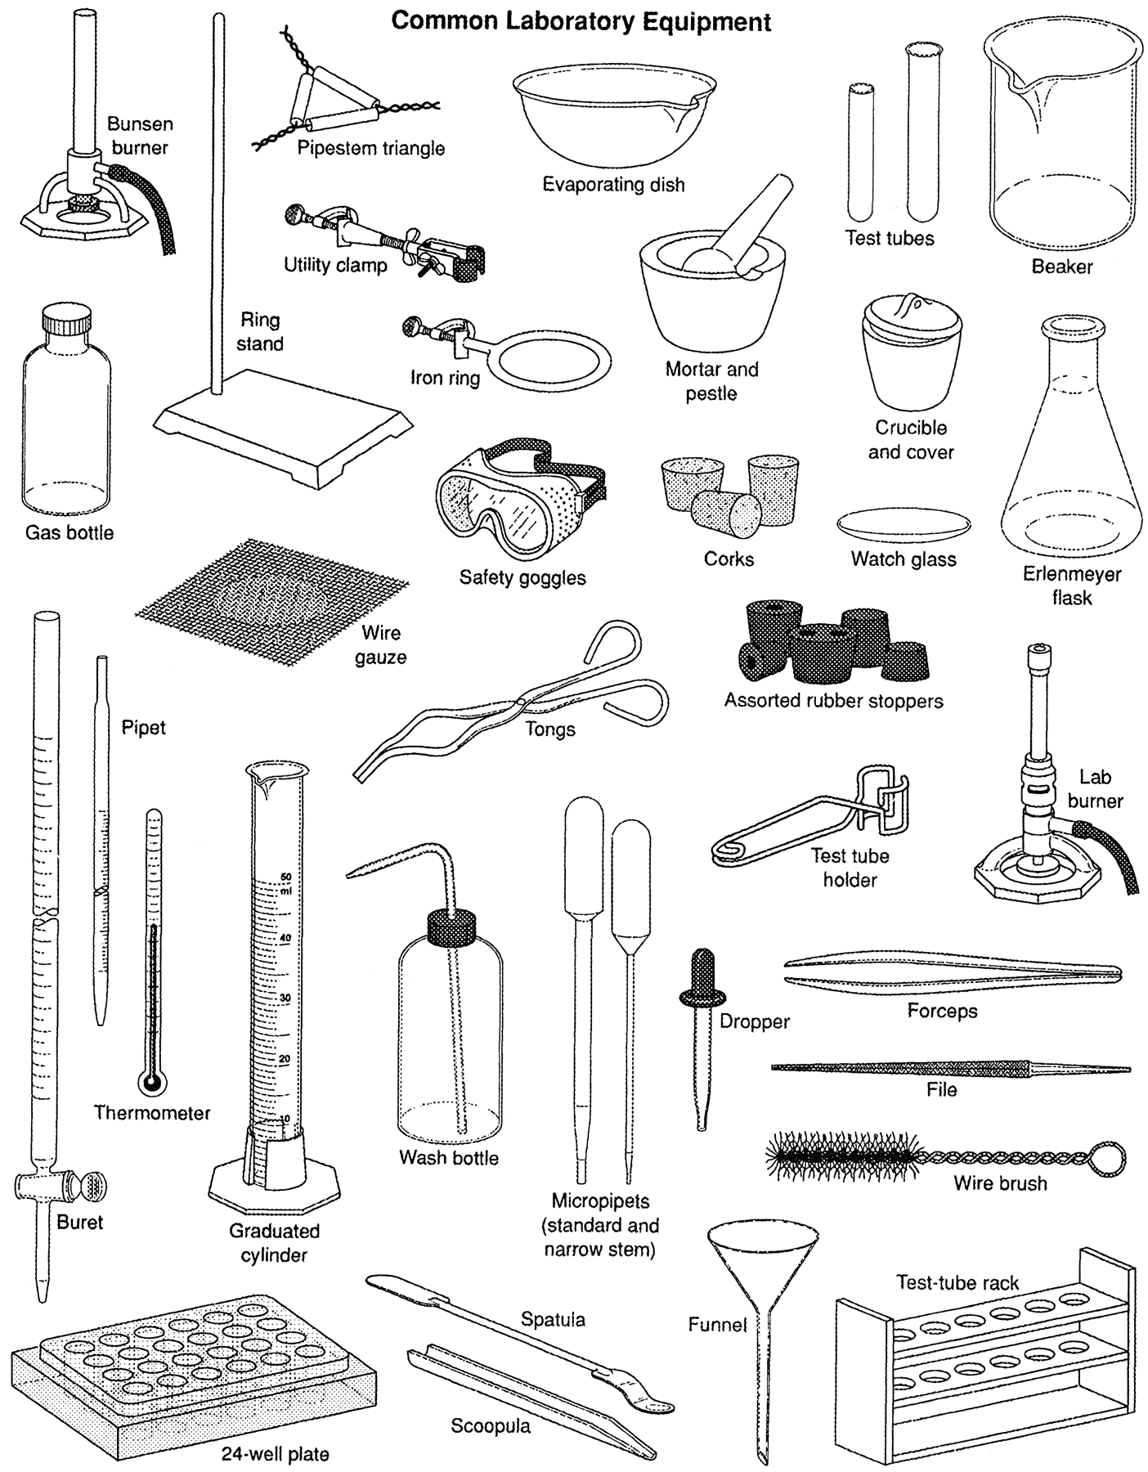
Chemistry – Aug 27, 2019
P3 Challenge – Do Now
Identify each of the following pieces of equipment and state its purpose.
Pick up 2 handouts
Objectives
  To learn Scientific and Engineering Practices
  To describe the Scientific Method
Agenda
  Chemistry Defined and the Nature of Science
  SEP
  Experimental Design
  Data Analysis
  Laws and Theories

Slide 2
Chemistry Defined
Chemistry is the scientific study of matter, its properties, and its changes.
Scientific Study…. using the scientific method
Of Matter…. anything that has mass and takes up space
  Mass and weight
Its Properties … what can we measure
Its Changes … how does matter change over time

Slide 3
Nature of Science
Observation
  Quantitative observations (measurements)
  Qualitative observations (descriptions)
Communication
  Without sharing information, observations are useless to advance human knowledge
  Replication
    Over time, place and observer
  Falsifiable, Testable
Serendipity and Chance discoveries – Penicillium, Teflon, X-rays
Notes:
Dr. Alexander Fleming, the bacteriologist on duty at St. Mary’s Hospital, returned from a summer vacation in Scotland to find a messy lab bench and a good deal more.
Upon examining some colonies of Staphylococcus aureus, Dr. Fleming noted that a mold called Penicillium notatum had contaminated his Petri dishes. After carefully placing the dishes under his microscope, he was amazed to find that the mold prevented the normal growth of the staphylococci.
The story of Teflon™ began April 6, 1938, at the Chemours Jackson Laboratory in New Jersey. Chemours chemist, Dr. Roy J. Plunkett, was working with gases related to Freon™ refrigerants, another Chemours product. Upon checking a frozen, compressed sample of tetrafluoroethylene, he and his associates discovered that the sample had polymerized spontaneously into a white, waxy solid to form polytetrafluoroethylene (PTFE).

Slide 4
Science and Engineering Practices (SEP)
8 NGSS SEP Categories 10 posters
1. Asking Questions and Defining Problems
2. Developing and Using Models
3. Planning and Carrying Out Investigations
4. Analyzing and Interpreting Data
5. Using Mathematics and Computational Thinking
6. Constructing Explanations and Designing Solutions
7. Engaging in Argument from Evidence
8. Obtaining, Evaluating and Communicating Information

Slide 5
Science and Engineering Practices (SEP)
*Engineering Problem on Fri
Scientific Practices
1. Asking Questions
2. Developing and Using Models
3. Planning and Carrying Out Investigations
4. Analyzing and Interpreting Data
5. Using Mathematics and Computational Thinking
6. Constructing Explanations
7. Engaging in Argument from Evidence
8. Obtaining, Evaluating and Communicating Information
Engineering Practices
1. Defining Problems
2. Developing and Using Models*
3. Planning and Carrying Out Investigations*
4. Analyzing and Interpreting Data
5. Using Mathematics and Computational Thinking
6. Designing Solutions*
7. Engaging in Argument from Evidence*
8. Obtaining, Evaluating and Communicating Information*

Slide 6
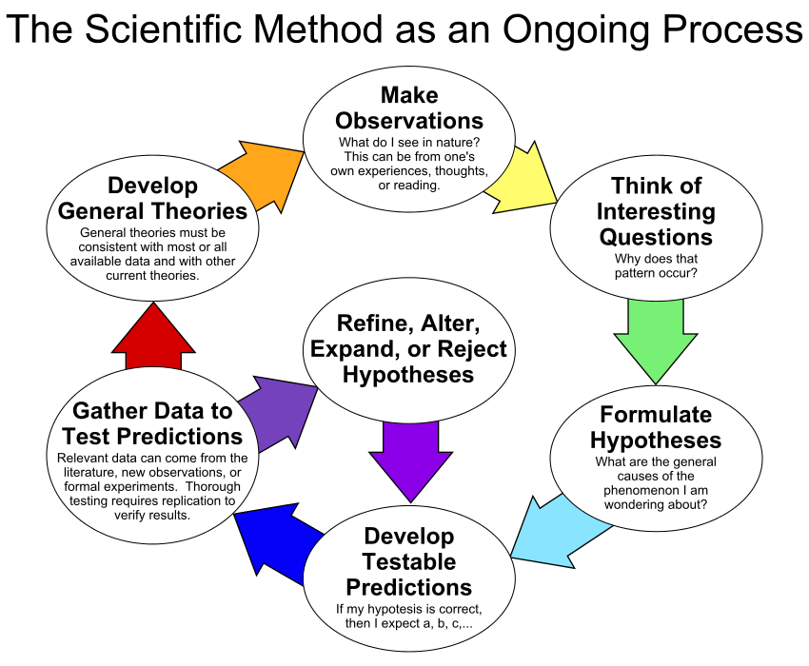
Experimental Design
Determine what factors or variables you are interested in studying.
Identify Independent and dependent variables. (IV and DV)
  Your experiment may have more than one of each.
An IV is one that you can manage and set levels or cases.
A DV is one that you observe.

Slide 7
Experimental Design
  A control is one cases where the IV is absent, yet all other features of the experiment remain the same, and the DV is observed.
  Controls necessary to show measurable effects, to rule out other explanations, to allow for conclusions to be drawn.
  A hypothesis is a guess about the relationship between your variables of interest.
  Science is not a linear process. See also Figure 8 on pg 46.

Slide 8
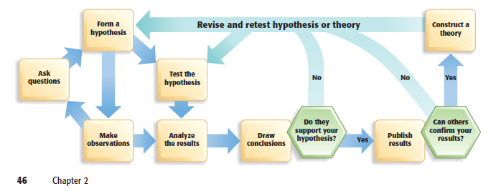
Another model of scientific method

Slide 9
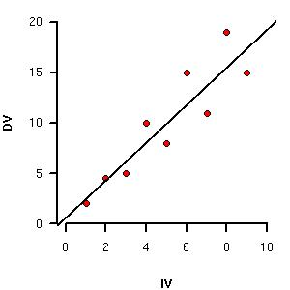
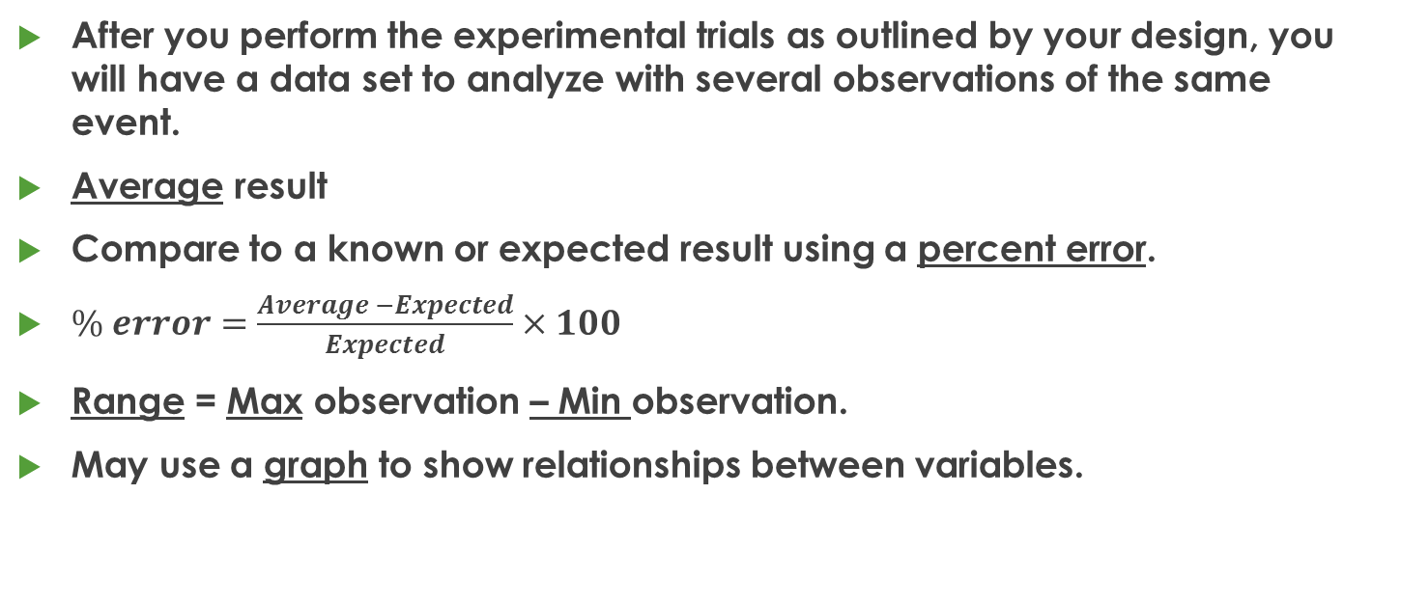
Data Analysis
After you perform the experimental trials as outlined by your design, you will have a data set to analyze with several observations of the same event.
Average result
Compare to a known or expected result using a percent error.
$\% error=\frac{Average −Expected}{Expected}×100$
Range = Max observation – Min observation.
May use a graph to show relationships between variables.

Slide 10
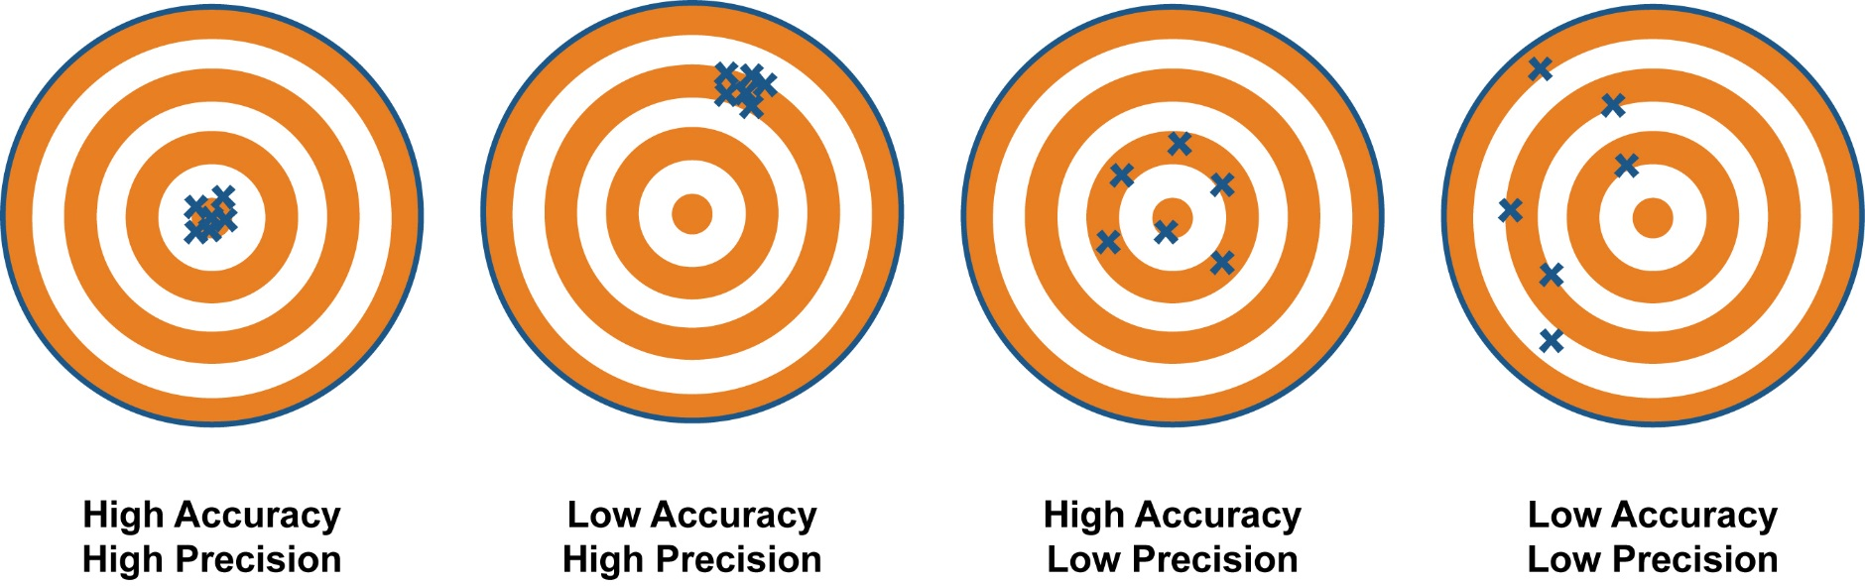
Accuracy and Precision
Accuracy – low % error – how close is the Average to the Expected
Precision – small range – how close are the data to each other

Slide 11
Evaluating Results
Two Sources of error account for the variability in data
  Systematic errors
  Random errors
Systematic (should be minimized with careful attention to lab techniques)
  Instrumental (Ex: Every piece of measuring glassware has an uncertainty associated with it. Marked on the glassware.)
  Procedural (Ex: During a chemical processing, every transfer from one vessel to another creates some additional error)
  Tends to influence resulting data to be skewed in one direction
  Related to accuracy

Slide 12
Evaluating Results
Random
  Can never remove uncertainty because of the fundamentally random nature of the motion of atoms.
  Influence of the observer (uncertainty principle)
  Tends to increase uncertainty of a measurement in all directions.
  Related to precision
Sources of Error vs a mistake

Slide 13
Laws and Theories
A scientific law is a statement or mathematical equation that reliably describes a behavior of the natural world.
  Ex: Law of Conservation of Mass – Antoine Lavoisier
  Summarizes macroscopic and atomic phenomena (What happens)
A scientific theory is a well-tested explanation of observations.
  Ex: John Dalton’s Atomic Theory
  Explains macroscopic and atomic phenomena (Why does it happen)
Conflicting Info for a theory → Revise or replace

Slide 14
Exit Slip - Homework
Exit Slip – Distinguish between Accuracy and Precision.
What’s Due? (Pending assignments to complete.)
  Scientific Method Word Games Worksheet
What’s Next? (How to prepare for the next day)
  Read p 10-15

